Slide 1
Quantum Simulators
RAJESH SATHYA KUMAR

Slide 2
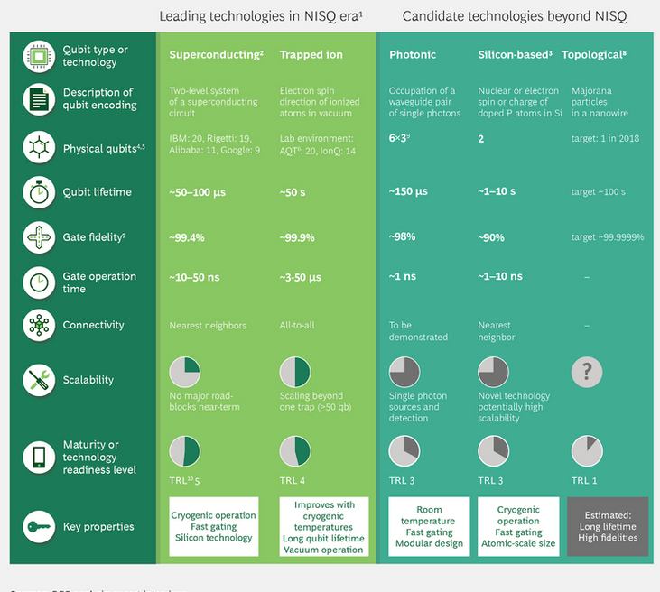
Types of quantum Hardwares
Notes:
Superconducting quantum computing is an implementation of a quantum computer in superconducting electronic circuits.
Ions, or charged atomic particles, can be confined and suspended in free space using electromagnetic fields. Qubits are stored in stable electronic states of each ion, and quantum information can be transferred through the collective quantized motion of the ions in a shared trap
Silicon Based Quantum Computers: https://phys.org/news/2022-01-quantum-silicon-accuracy.html

Slide 3
Functions of a quantum simulator
Quantum simulators are software programs that run on classical computers and act as the target machine, making it possible to run and test quantum programs in an environment that predicts how qubits will react to different operations.
The quantum simulator is responsible for providing implementations of quantum operations for an algorithm.
This includes primitive operations such as H, CNOT, and Measure, as well as qubit management and tracking.
The Quantum Development Kit includes different classes of quantum simulators representing different ways of simulating the same quantum algorithm.

Slide 4
Available simulators
IBM’s Qiskit
Google’s Cirq
Amazon’s AWS Bracket
Microsoft’s Q# and Azure Quantum
Rigetti’s Forest
Xanadu’s Pennylane

Slide 5
Software comparison
Simulators | Company | Supported Softwares | Hardwares
Qiskit | IBM | Python library | Superconducting Qubit
Cirq and Tensorflow Quantum | Google | Python library | Superconducting Qubit
AWS Bracket | Amazon | IonQ, Rigetti, D-Wave | Only a cloud provider to other hardwares
Q# and Azure Quantum | Microsoft | Q# | Topological Qubit
Rigetti / PyQuil / Forest SDK | Rigetti Computing | Python | Superconducting Qubit
Strawberry fields | Xanadu | Python library | Silicon quantum Photonic chips
Pennylane | Xanadu | Cross-platform python library | Supports Qiskit, Amazon Bracket, Strawberry fields, Cirq, Qulacs, AQT, Honeywell, Microsoft QDK, Rigetti Forest, IonQ, Orquestra, ProjectQ

Slide 6
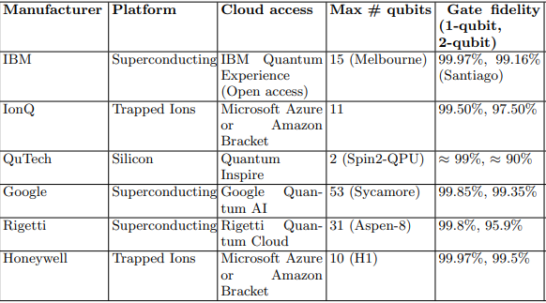
Hardware comparison

Slide 7
Literature review
Overview and Comparison of Gate Level Quantum Software Platforms, Ryan LaRose
Quantum computing hardware in the cloud: Should a computational chemist care? Alessandro Rossi, Paul G. Baity, Vera M. Schafer, and Martin Weides
“What To Look For In A Quantum Machine Learning Framework” – link
“Trapped Ion, Superconducting, and Photonic” - link

Slide 8
THANK YOU

